Slide 1
Terraform for Azure

Slide 3
Terraform to Azure Module 05 - Terraform Pipeline with Azure Pipeline
Notes:
https://developer.hashicorp.com/terraform/tutorials/modules/module

Slide 4
Overview
After completing this learning unit, you will understand
Azure DevOps
Pipelines

Slide 5
Azure DevOps

Slide 6
What is DevOps?
People. Process. Products.
Build& Test
Deploy
DevOps is the union of people, process, and products to enable continuous delivery of value to your end users.
“
Continuous Delivery
Develop
Operate
”
Plan & Track
Monitor & Learn
Notes:
DevOps is the union of people, process and products to enable the continuous delivery of value to your end customers

Slide 7
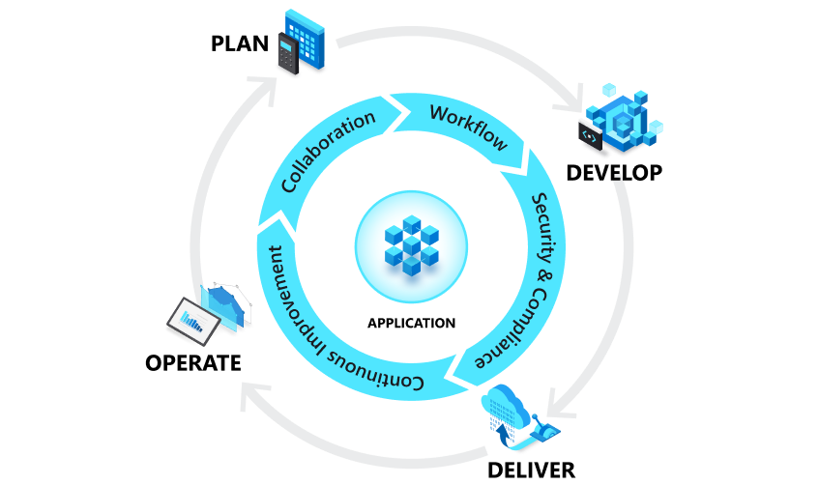
How to Achieve DevOps
Microsoft Confidential
Notes:
DevOps is the union of people, process, and products to enable continuous delivery of value to our end users.

Slide 8





Introducing Azure DevOps
Azure Boards
Azure Pipelines
Azure Repos
Deliver value to your users faster using proven agile tools to plan, track, and discuss work across your teams.
Build, test, and deploy with CI/CD that works with any language, platform, and cloud. Connect to GitHub or any other Git provider and deploy continuously.
Get unlimited, cloud-hosted private Git repos and collaborate to build better code with pull requests and advanced file management.
Azure Test Plans
Azure Artifacts
➔
Test and ship with confidence using manual and exploratory testing tools.
Create, host, and share packages with your team, and add artifacts to your CI/CD pipelines with a single click.
https://azure.com/devops
Notes:
So does TFS

Slide 9

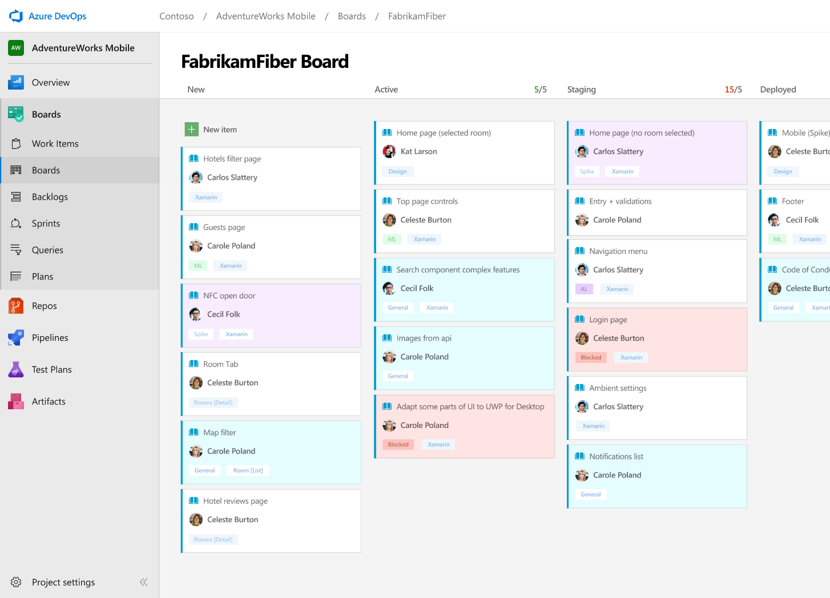



Azure Boards
Track work with Kanban boards, backlogs, team dashboards, and custom reporting
Connected from idea to release
Scrum ready
Project insights
➔
https://azure.com/devops
Notes:
Combine Kanban boards and drag-and-drop sprint planning with comprehensive traceability and reporting for the perfect home for all your ideas–big and small.
Track all your ideas at every development stage and keep your team aligned with all code changes linked directly to work items.
Use built-in scrum boards and planning tools to help your teams run sprints, stand-ups, and planning meetings.
Gain new insights into the health and status of your project with powerful analytics tools and dashboard widgets.

Slide 10
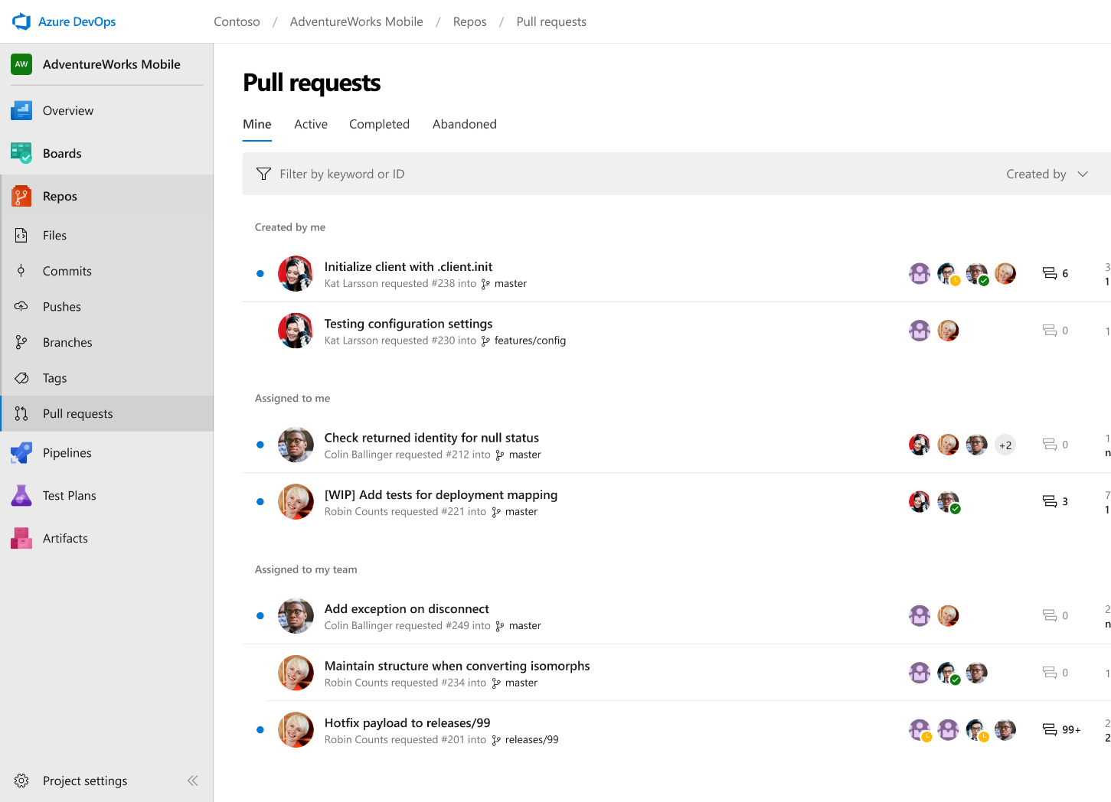



Azure Repos
Unlimited private Git repo hosting and support for TFVC that scales from a hobby project to the world’s largest Git repositories
Works with your Git client
Web hooks and API integration
Semantic code search
➔
https://azure.com/devops
Notes:
Collaborate on code changes with threaded discussion and continuous integration for each change. Use forks to promote collaboration with Inner Source workflows.
Securely connect with and push code into your Git repos from any IDE, editor, or Git client.
Add validations and extensions from the marketplace or build your own using web hooks and REST APIs.
Quickly find what you’re looking for with code-aware search that understands classes and variables.

Slide 11

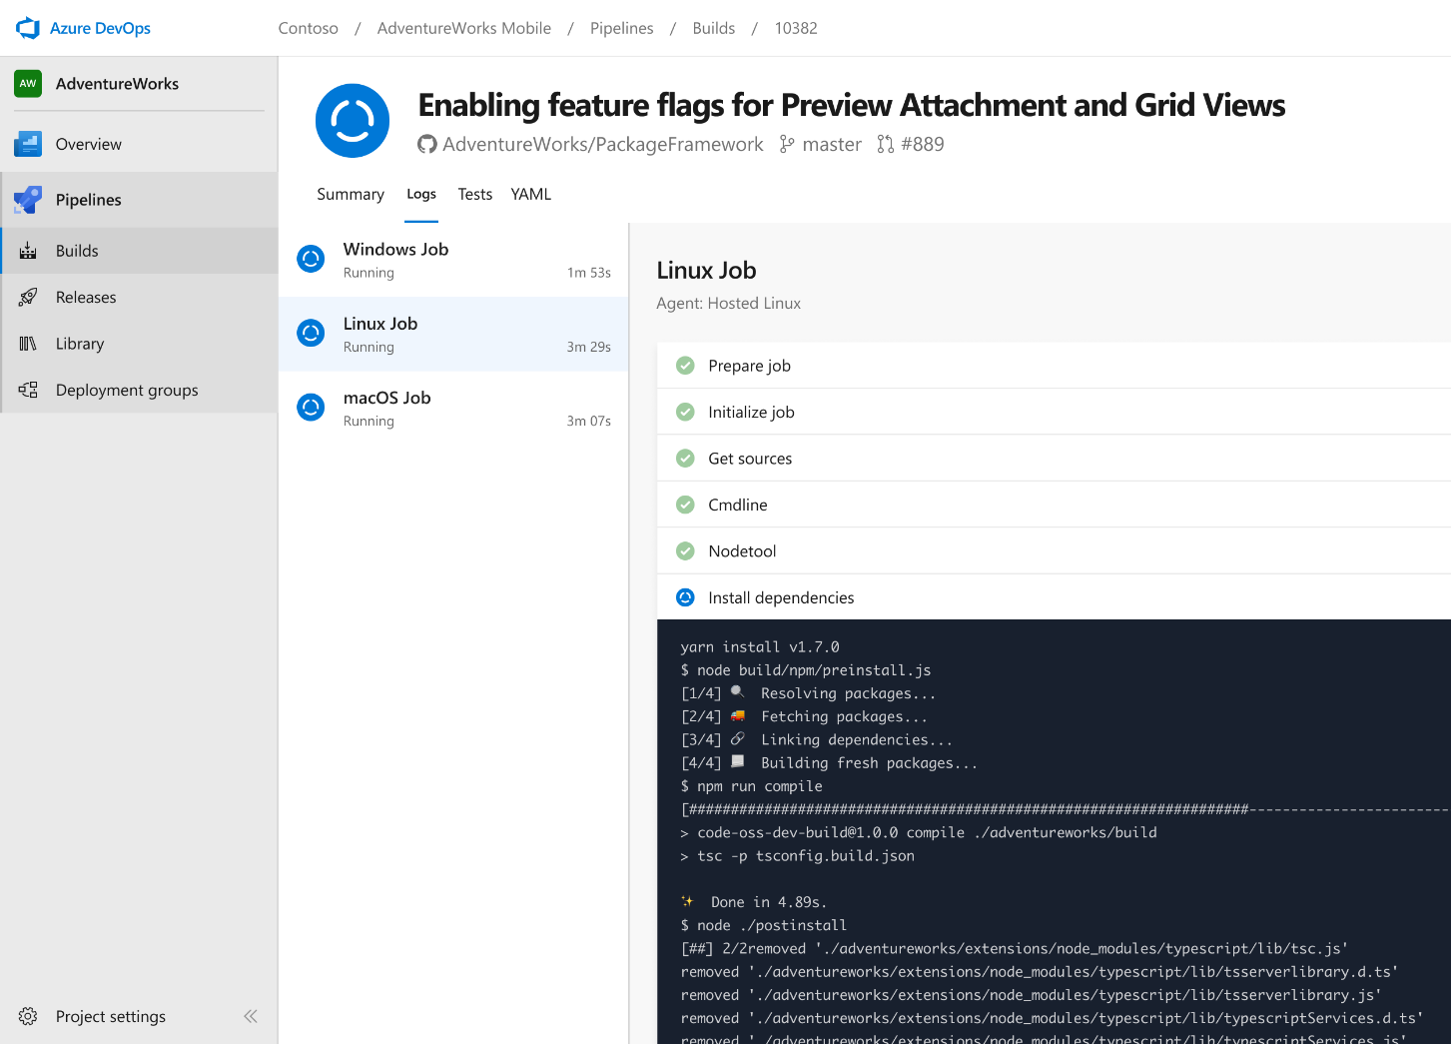


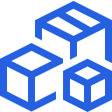

Azure Pipelines
Cloud-hosted pipelines for Linux, Windows and macOS, with unlimited minutes for open source
Any language, any platform, any cloud
Extensible
Containers and Kubernetes
Best-in-class for open source
➔
https://azure.com/pipelines
Notes:
Azure Pipelines is the perfect launchpad for your code – automating your builds and deployments so you spend less time with the nuts and bolts and more time being creative
Build, test, and deploy Node.js, Python, Java, PHP, Ruby, C/C++, .NET, Android, and iOS apps. Run in parallel on Linux, macOS, and Windows. Deploy to Azure, AWS, GCP or on-premises
Explore and implement a wide range of community-built build, test, and deployment tasks, along with hundreds of extensions from Slack to SonarCloud. Support for YAML, reporting and more
Easily build and push images to container registries like Docker Hub and Azure Container Registry. Deploy containers to individual hosts or Kubernetes.
Ensure fast continuous integration/continuous delivery (CI/CD) pipelines for every open source project. Get unlimited build minutes for all open source projects with up to 10 free parallel jobs across Linux, macOS and Windows

Slide 12
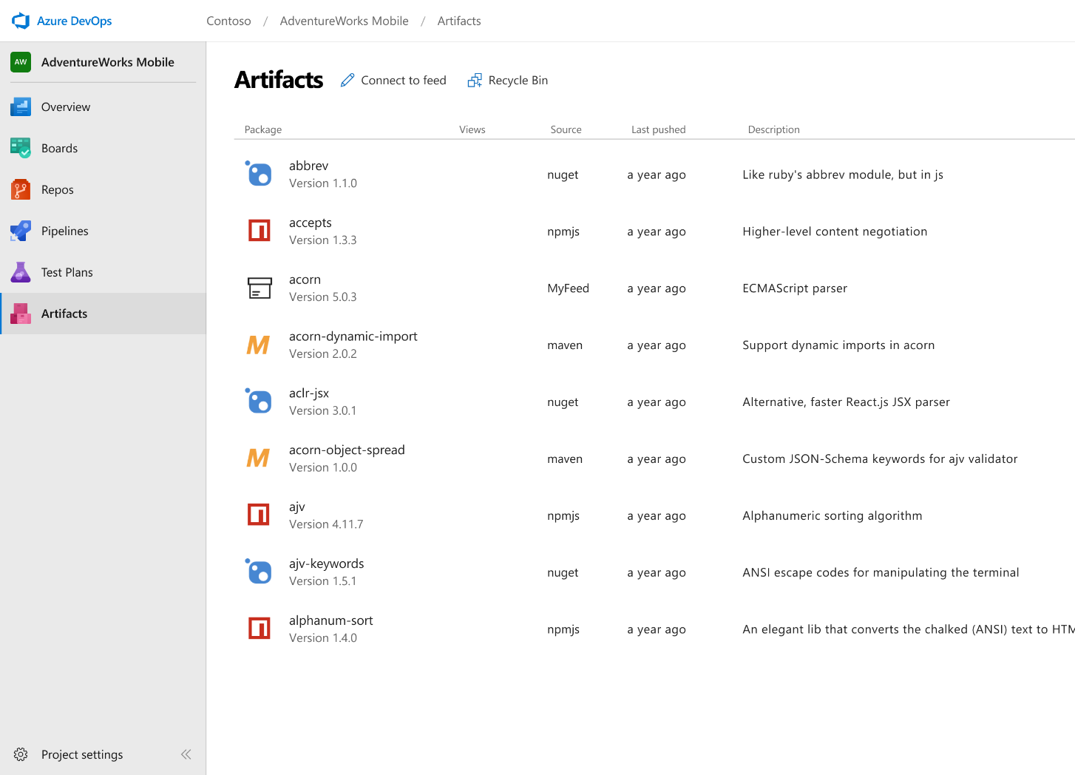



Azure Artifacts
Create and share Maven, npm, and NuGet package feeds from public and private sources – fully integrated into CI/CD pipelines
Manage all package types
Add packages to any pipeline
Share code efficiently
➔
https://azure.com/devops
Notes:
Collaborate on code changes with threaded discussion and continuous integration for each change. Use forks to promote collaboration with Inner Source workflows.
Get universal artifact management for Maven, npm, and NuGet.
Share packages, and use built-in CI/CD, versioning, and testing.
Easily share code across small teams and large enterprises.

Slide 13
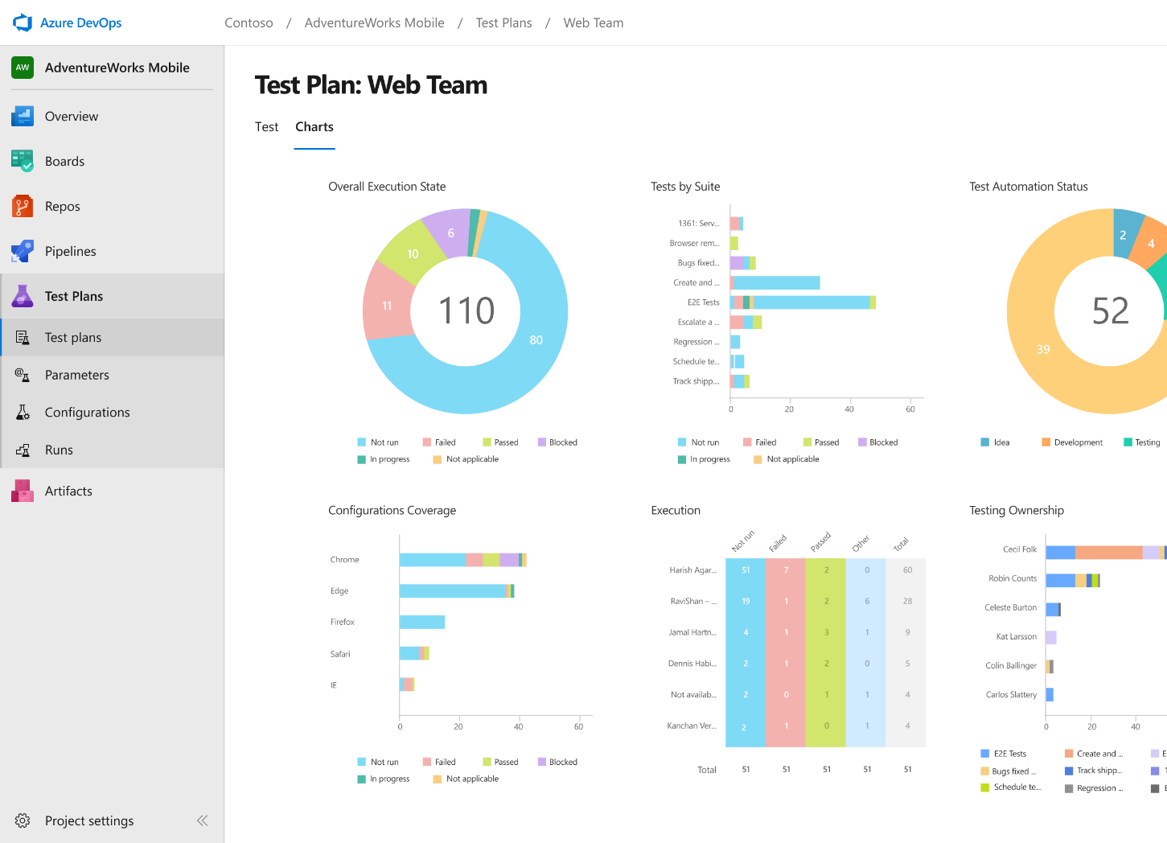
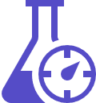

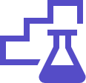
Azure Test Plans
Get end-to-end traceability. Run tests and log defects from your browser. Track and assess quality throughout your testing lifecycle.
Capture rich data
Test across web and desktop
Get end-to-end traceability
➔
https://azure.com/devops
Notes:
Collaborate on code changes with threaded discussion and continuous integration for each change. Use forks to promote collaboration with Inner Source workflows.
Capture rich scenario data as you execute tests to make discovered defects actionable. Explore user stories without test cases or test steps. You can create test cases directly from your exploratory test sessions.
Test your application where it lives. Complete scripted tests across desktop or web scenarios. Test on-premises application from the cloud and vice-versa.
Leverage the same test tools across your engineers and user acceptance testing stakeholders. Pay for the tools only when you need them.

Slide 14


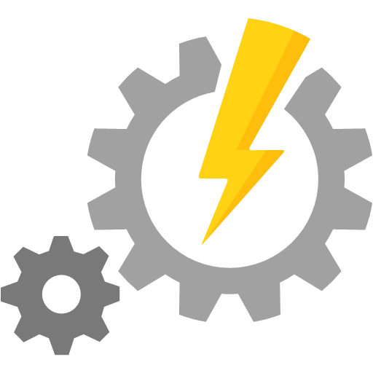



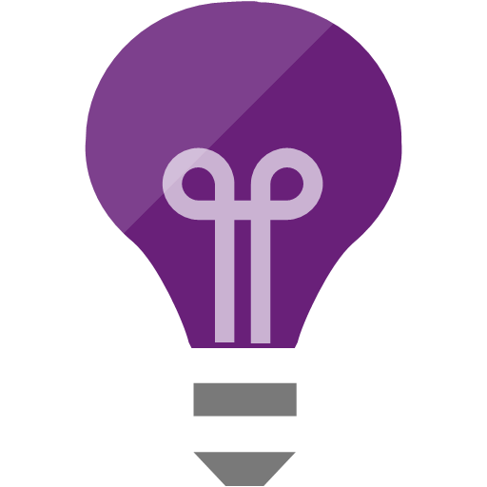

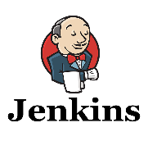
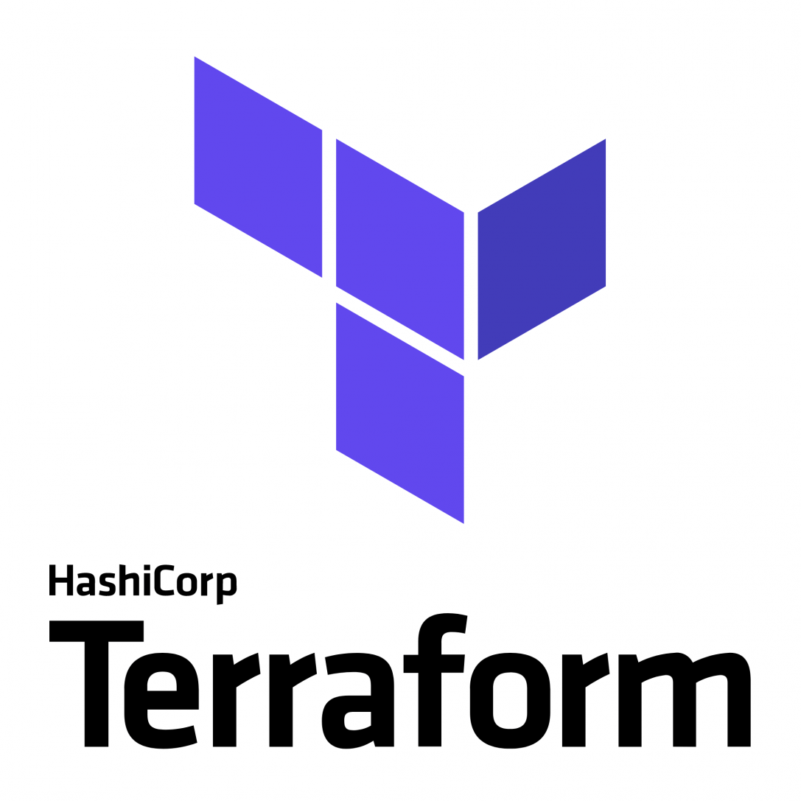
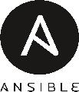


Broadening the Azure Ecosystem
Notes:
So does TFS

Slide 15
Pipelines

Slide 16
What is Azure Pipelines?
Cloud service that you can use to automatically build and test your code project and make it available to other users.
Works with just about any language or project type.
Fully featured continuous integration (CI) and continuous delivery (CD) service
Helps to ensure consistent and quality code that's readily available to users
Start with your code on GitHub, GitLab, Bitbucket, or Azure Repos. Then you can automate the build, test, and deployment of your code to Microsoft Azure, Google Cloud, Amazon cloud services or on-prem

Slide 17
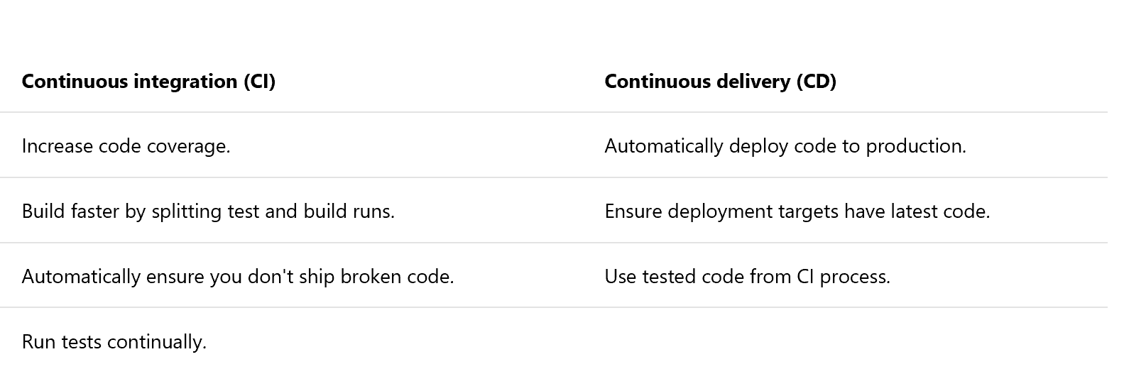
Continuous Integration (CI) and Continuous Delivery (CD)

Slide 18
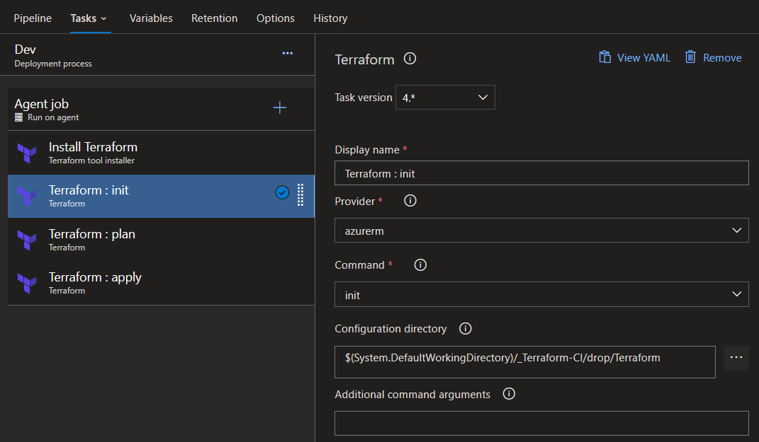
Classic Build / Release

Slide 19
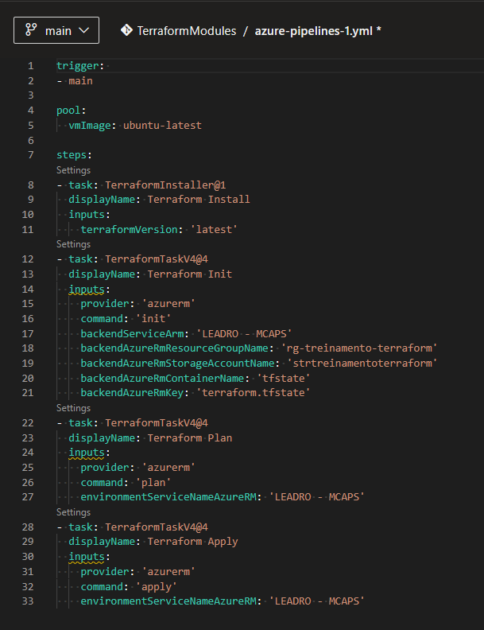
YML Pipeline

Slide 20
Agents
To build your code or deploy your software you need at least one agent. As you add more code and people, you'll eventually need more.
When your build or deployment runs, the system begins one or more jobs. An agent is installable software that runs one build or deployment job at a time.

Slide 21
Agents
Microsoft-hosted
Simplest way to build and deploy
Maintenance and upgrades are taken care of for you
Each time you run a pipeline, you get a fresh virtual machine. The virtual machine is discarded after one use.
Self-hosted
Set up and manage on your own to run build and deployment jobs
Gives you more control to install dependent software needed for your builds and deployments
You can install the agent on Linux, macOS, or Windows machines. You can also install an agent on a Linux Docker container.
Can be configured as a service or an interactive process

Slide 22
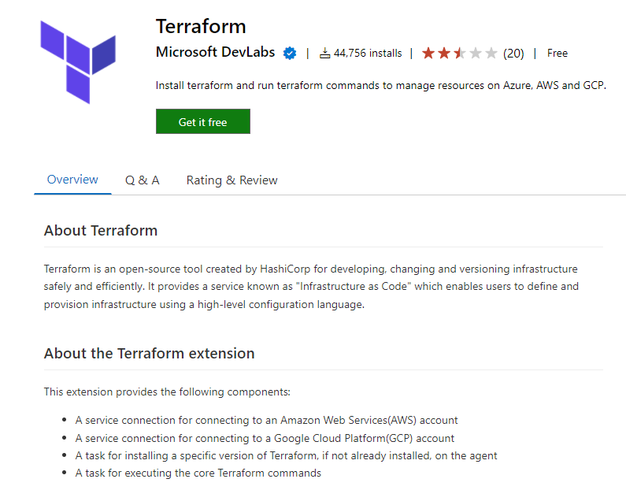
Terraform Tasks

Slide 23
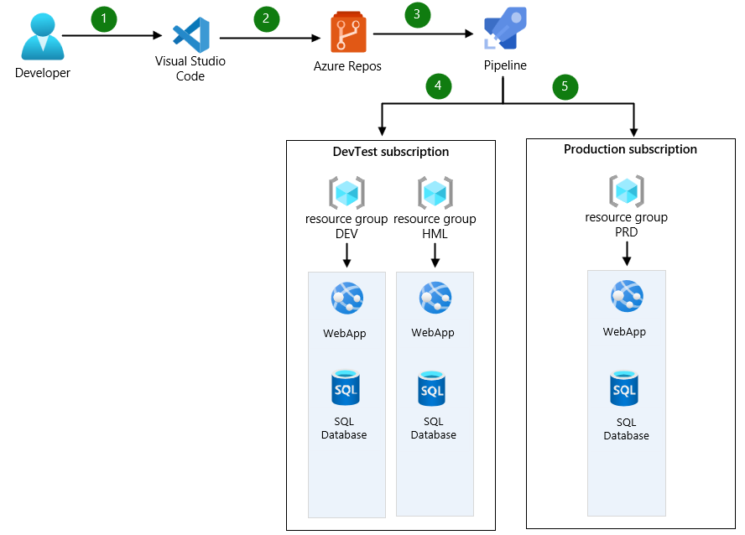
DevOps Process

Slide 24
DEMO

Slide 25
QUESTIONS Leandro Prado leandro.prado@microsoft.com

